Slide 1
Accurate light-time correction due to a gravitating mass A mathematical follow-up to Cassini’s experiment
Bruno Bertotti
Dipartimento di Fisica Nucleare e Teorica
Università di Pavia, Italy
Neil Ashby
Department of Physics
University of Colorado, Boulder (USA)
Paper in preparation

Slide 2
A careless dismissal
A test of General Relativity using radio links with the Cassini spacecraft
B. Bertotti*, L. Iess† and P. Tortora‡
γ = 1 + (2.1 ± 2.3)×10⁻⁵
A
O
Second-order terms neglected; but
B
This expression has some second-order corrections, but not all (no second-order metric)

Slide 3
Concern
What is the order of magnitude of the neglected second-order terms?
Do they invalidate Cassini’s result?

Slide 4
Redress
Cassini’s results are not affected
Second order delay obtained in general
Enhancement tamed

Slide 5
A mathematical follow-up to Cassini’s experiment is needed
In the DSN phase differences are measured, not frequency changes; the appropriate
mathematical observable is the light-time between an event A and an event B, greater than
the geometrical distance r_{AB} by the gravitational delay Δt.
Standard formula:
A
O
ODP does not use the standard formula, but
The correction is of second order, but it ignores second-order
metric and is inconsistent. Does it affect the result?
B

Slide 6
How large is the ODP correction ?
In a close conjunction
Moyer’s “correction” is of order
Dangerous! Enhancement phenomenon

Slide 7
Asymptotic series
Selection of terms cannot be based on empirical order of magnitude estimates, but on automatic formal expansions in powers of m/b₀ , like:
Asymptotic expansions are defined by their
coefficients and by the limiting property:
as m → 0, at k-order the residual → 0 as m^{k+1}
They are not ordinary functions: e.g.,
The main problem: the order of magnitude of the coefficients Δ_{s} . If r_{A} /b₀, r_{B}/b₀ = O(1),
Δ_{s} = O(1). But in a close conjunction r_{A} /b₀, r_{B}/b₀ = O(R/b₀) >> 1and second-order terms of order

Slide 8
Order of infinitesimal
m is not a fixed quantity, but a parameter which tends to nought
Asymptotic series provide an automatic and safe way to decide which terms to keep

Slide 9
Fermat’s Principle
Isotropic coordinates! Orbital propagation in solar system uses isotropic coordinates,
Lorentz-transformed to barycentric system.
Light propagates in space as in a refractive medium (Eikonal approach) with refraction index
, Ferrmat’s action functional, has a minimum on the actual ray. This minimum is equal to the light-time t_{B ¬} t_{A}

Slide 10
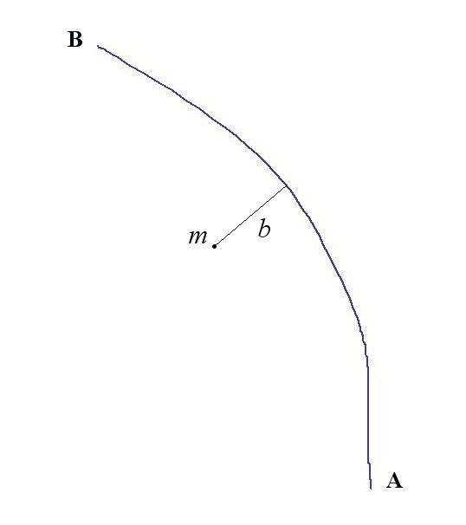
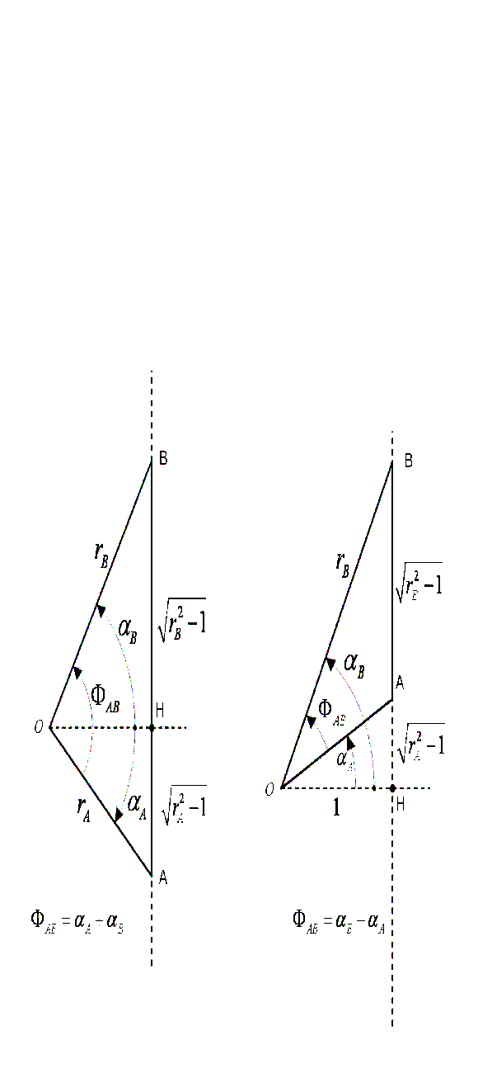
The ray
B
m
b
Obtuse case
(usual)
(b₀ =1)
Acute case
(not considered)
A
Actual ray: b > b_{0.}
We also use h = bN(b) (impact parameter)
r _{A} , r _{B} , Φ_{AB} constitute the experimental setup and are fixed.

Slide 11
The eikonal
Solve for E (t,r) by separation of variables

Slide 12
The action
Let S(h) be Fermat’s functional S(A,B) when the variability of its argument (any line between A and B) is restricted to the coordinate of closest approach b (or h). S(h) is called reduced action.
Positive contributions from ingoing and outgoing branch.
This minimum is equal to the light-time.
To solve S’(h) =0, use the power expansion.
Since m is infinitesimal, in going from
h₀ to h₀ + mh₁ the reduced action does not change. Hence the first order light-time does not depend on h₁; indeed,
Similarly, in going from h₀ + mh₁ to h₀ + mh₁+ m²h₂ the reduced action does not change; the second-order light-time does not depend on h_{2.}
S(h)
Light-
time
h
“True” h

Slide 13
Second order light-time (obtuse case)
Not enhanced Enhanced

Slide 14
Enhancement
Deflection is different:
where δ_{s} ~ 1 is pure number (δ₁ = 2(1+ γ)) , because no dimensional quantities are involved. Similarly, when r_{A} ~ b ₀ , r_{B} ~ b ₀ , Δ _{s} ~ 1; but 1 AU/R_{sun} = 200 >> 1 !!. When r_{A} >> b ₀ , r_{B} >> b ₀ Δ₂ = O(R/ b ₀) cannot be excluded; it corresponds to a change in γ which can be 200 times greater, detectable with σ _{γ} ~ 2 x 10⁻⁵, about Cassini’s value !! In an asymptotic expansion, one can expect dimensionless coefficients to be of order unity only if their arguments are also of order unity
A dangerous situation.

Slide 15
Enhancement
Second-order light-time
Find the limit of
as b₀/R →0
ODP formula recovered!

Slide 16
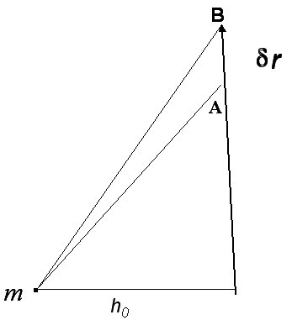
Light-time corrections for LISA
One year periodicity; masked by acceleration noise

Slide 17
Conclusions
Cassini’s results are not affected
Second order delay obtained in general
Enhancement in a close conjunction understood

Slide 18
Variational Lemma
S(h)
The change of h with m is described by
but since S(h) is minimum at “true “ h, at order m the light-time does not depend on h_{1.} In fact, at first order
Light-
time
h
“True” h
For simplicity, take h₀ = b₀ = 1.
Similarly, at order m² the light-time does not depend on h_{2,}, etc. Great simplification!

